Slide 1
This Week Work Progress
Lecturer：SUSTech Li Yuchen
2019.1.30

Slide 2
content
01
Reading Code & Recurring paper
02
Image Processing
03
Studying machine learning & Tensorflow

Slide 3
Reading paper & Recurring paper
Part One
01

Slide 4
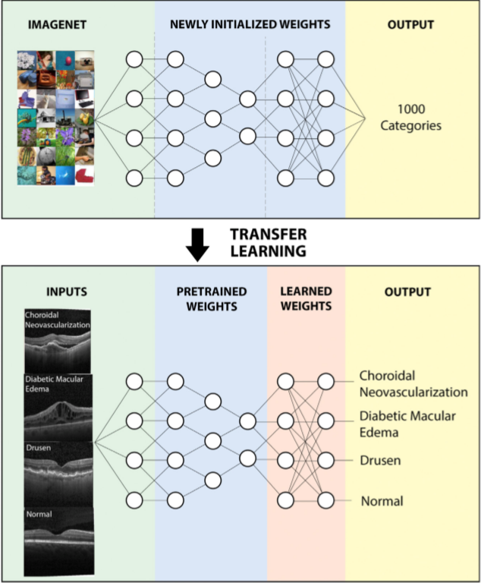
Cell: Identifying Medical Diagnoses and Treatable Diseases by Image-Based Deep Learning

Slide 5
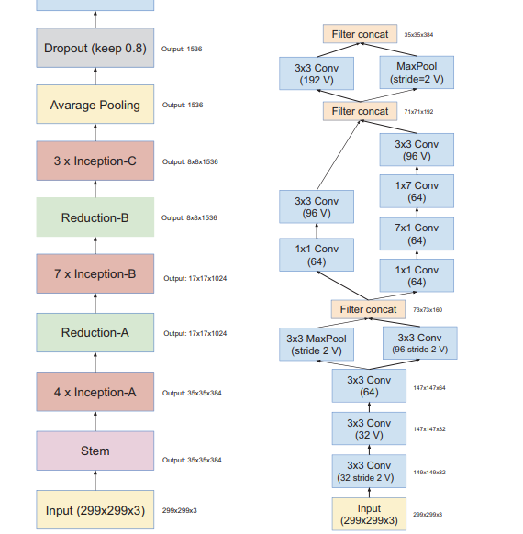
Reading Paper
Inception-v4,Inception-ResNetand the Impact of Residual Connections on Learning
1. Are there any benefits to combining Inception architectures with residual connections?
Application ： object-detection, segmentation, human pose estimation, video classification, object tracking, super-resolution
The dataset comprises of 1.2 million training images, 50,000 validation images and 100,000
test images.
2. combination of two of the most recent ides: Residual connections & the latest revised version of the Inception architecture.

Slide 6
Image Processing
Part Two
02

Slide 7
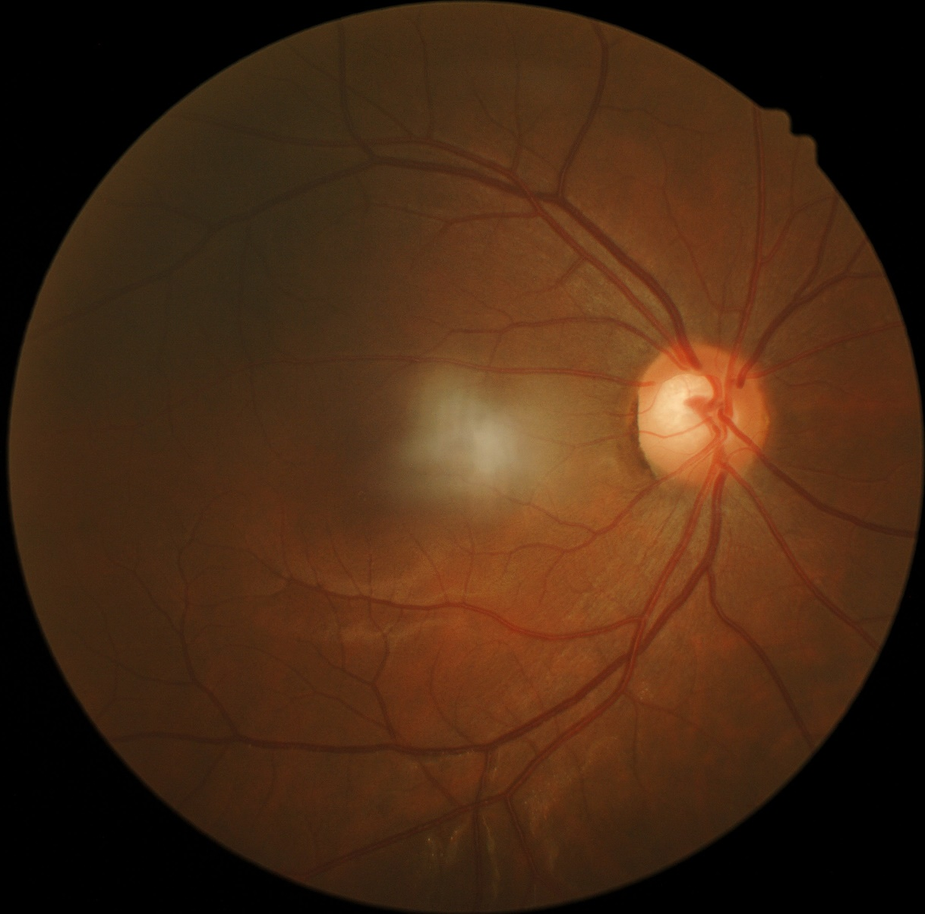
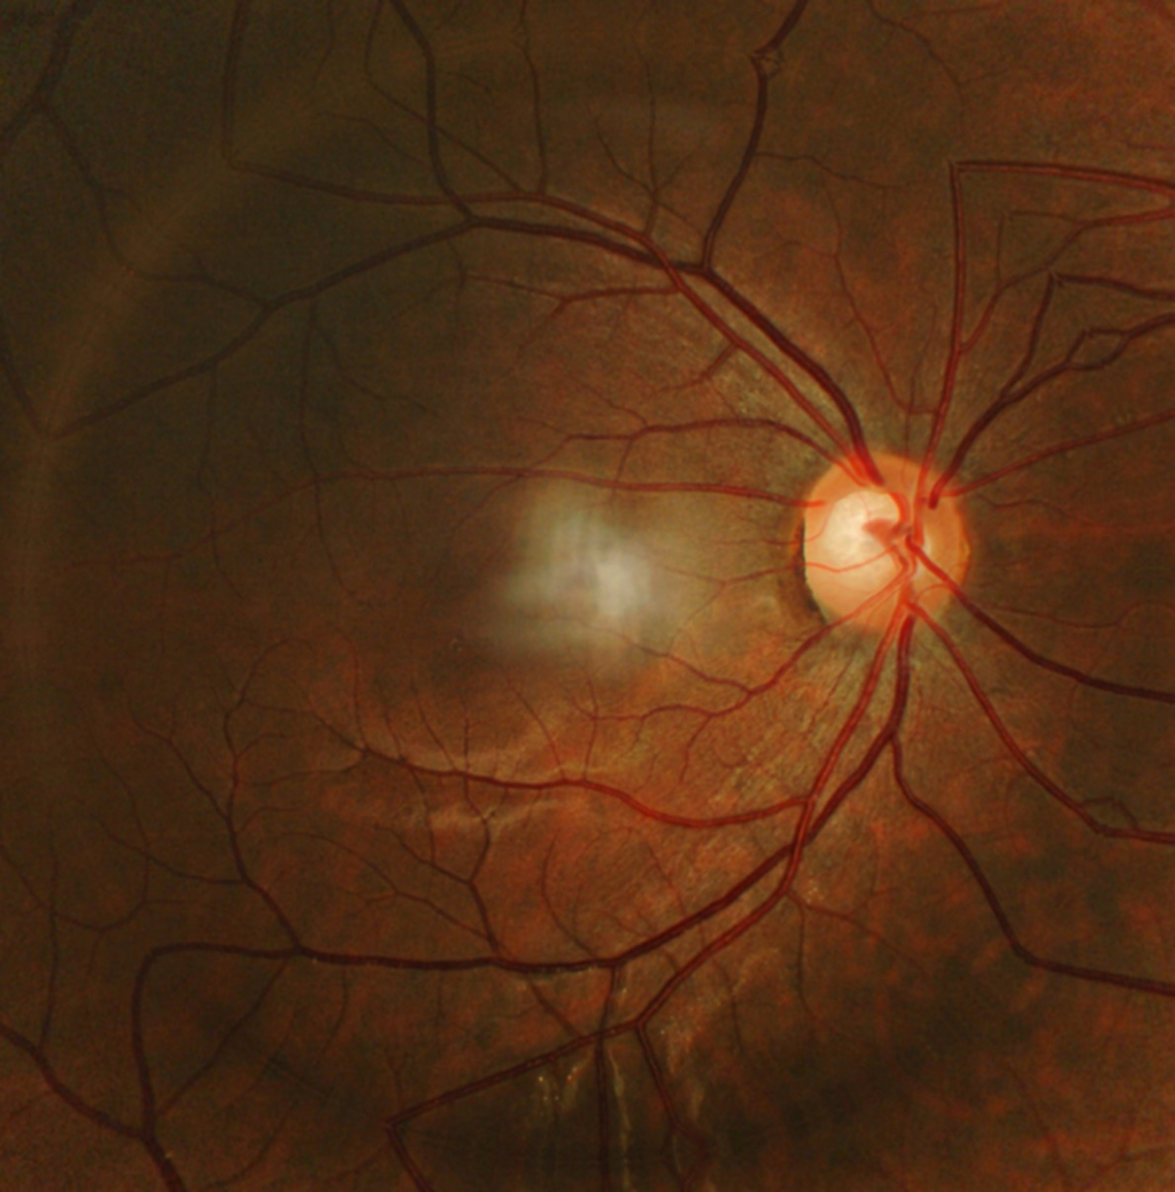
Image Enhancement

Slide 8
Run the Both Dataset

Slide 9
Study
Part Three
03

Slide 10
Future plan
01
Analyze the reasons & find questions
02
Try the methods
02
Study

Slide 11
THANKS
And Your Slogan Here.

